Slide 1
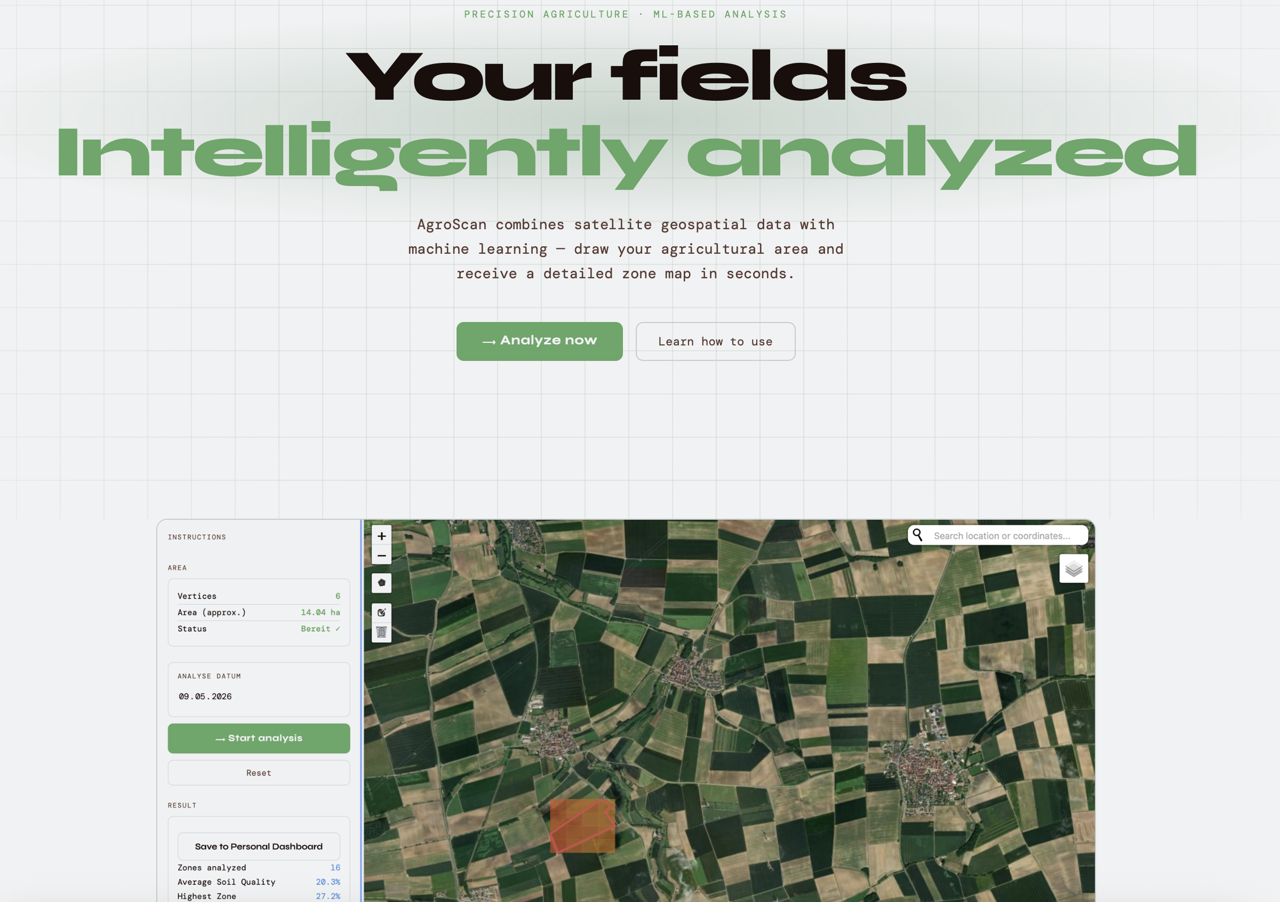
Progress Update – Satellite-powered SOC Monitoring (1/2)
Website - Tasks
Status
Implement search function
Check out our website by deploying it locally! Please select a small field for quicker compilation.
Add data download option
Add personal dashboard page
>
Prepare connection with model
Future work:
Completion of UI/UX design & finish website text
Test user friendliness design principles
Remote deployment of website
Finalize website design incl. layout, text & functionalities

Slide 2
Progress Update – Satellite-powered SOC Monitoring (2/2)
ML Model - Tasks
Status
Develop satellite data download & pre-processing pipeline
Sentinel 2 data download and processing pipeline completed & tested; Sentinel 1 data de-prioritized
Select case region
Selected Germany a case study
Train ML model
Selected & trained fully-connected neural network on Germany
>
Develop wrapper for automatic data download, processing, and OC prediction
Integrated ML model into website, implemented user interaction with model
Integrate ML model into website
Future work:
Debug connection of model and
website
Implement changes in ML model when switching from local to remote deployment

Slide 3
Questions – Satellite-powered SOC Monitoring
We are running into issues when trying to deploy the website remotely. The first two out of three steps work, and within the third step we run into a timeout error. Based on our Gitlab Repo, do you have a suggestion what could cause the error?
Based on the user selection of a field on our website the corresponding satellite data is downloaded and used as an input for the prediction. When the website is locally deployed this data is stored on our personal laptop. When deploying the website remotely, where can this data be stored? Can this be stored permanently or only temporarily?
How can we speed up the satellite data download? As of now the user has to wait around 4-5 minutes before getting the analysis results.
Our research question is: How can a ML model be utilized to empower farmers to monitor and manage carbon stock in their agricultural soils? Can you give us feedback on the definition of the RQ, and to what extent our project answers it?
The script sentinel_download.py raises the following error on a windows computer but not on a macOS: [DL Thread 3] [WinError 32] Der Prozess kann nicht auf die Datei zugreifen, da sie von einem anderen Prozess verwendet wird: 'C:\\tmp\\pt_6.zip’. Do you have a suggestion what could cause the error?
How well does the project fulfill your and the course’s expectation? Do you notice any key missing elements?

